Slide 1

PANDEMIC & NYC ENERGY, GAS, & PUBLIC TRANSPORTATION TRENDS
Brought to you by Smart Pandas
Joseph Orta, Erika Anglin, Frank Ditz, Dillon Kleinman, Herbert Spektor

Slide 2
In this project, we measured energy, gas, consumption, and traffic trends in NYC. The objective of this study is to better understand how consumer behavior has changed before, during, and after the pandemic.

Slide 3
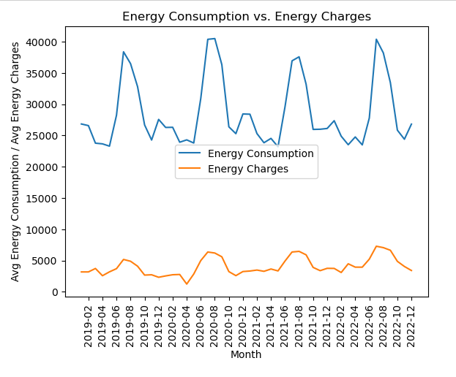
PANDEMIC & NYC ENERGY, GAS, & PUBLIC TRANSPORTATION TRENDS
1(A). How has the energy price and energy consumption changed over time? Are they correlated?
Findings: Energy consumption and charges rates appear to be correlated. For every year tested, as energy consumption increased, so did energy charges. Energy consumption and charges peaked around August for each of the years tested.

Slide 4
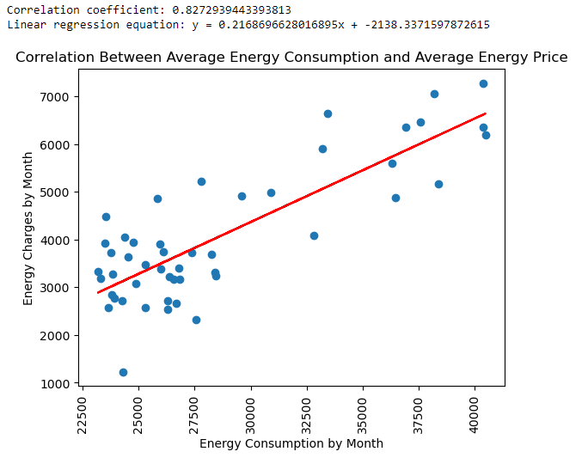
PANDEMIC & NYC ENERGY, GAS, & PUBLIC TRANSPORTATION TRENDS
1(B). How has the energy price and energy consumption changed over time? Are they correlated?
Findings: Similar to what we were able to visualize in the line chart, the two metrics are highly correlated with a correlation coefficient of 0.83.

Slide 5
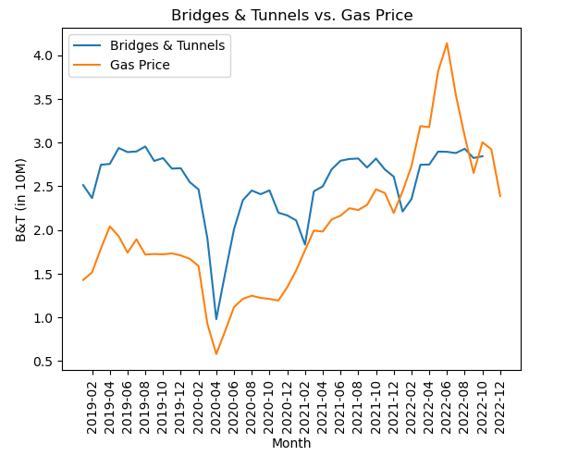
PANDEMIC & NYC ENERGY, GAS, & PUBLIC TRANSPORTATION TRENDS
2(A) Has the consumer usage of cars/buses affected gas prices?
Findings: We found that in the first two years, and especially between February 2020 to June 2020 (the pandemic lockdown months), the drop in traffic is highly correlated to the drop in gas price.

Slide 6
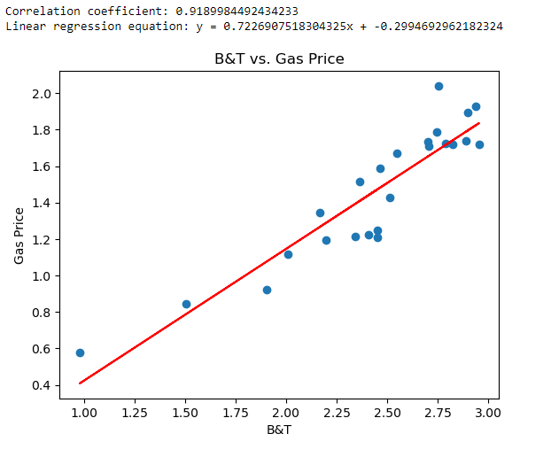
PANDEMIC & NYC ENERGY, GAS, & PUBLIC TRANSPORTATION TRENDS
2(B) Correlation Coefficient and Regression Model
Findings: The line regression and correlation coefficient of 0.92 indicate that there is strong evidence for a positive correlation between traffic and gas price.

Slide 7
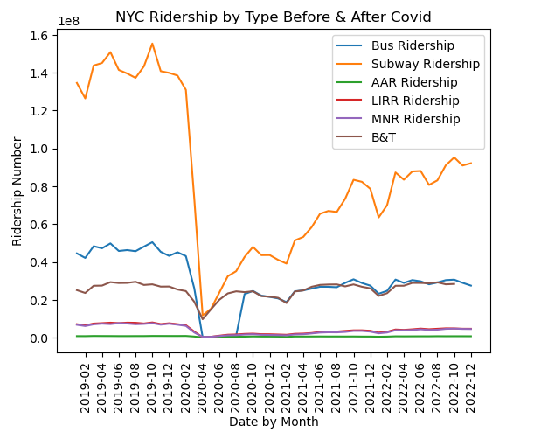
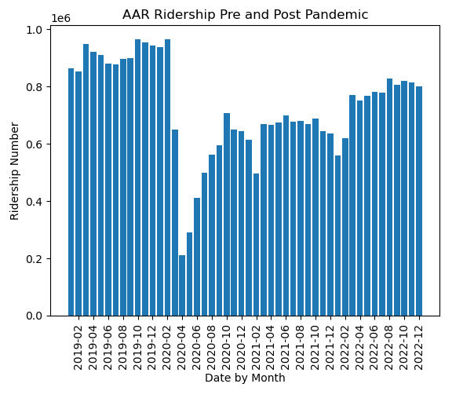
PANDEMIC & NYC ENERGY, GAS, & PUBLIC TRANSPORTATION TRENDS
3(A). Has public transportation usage returned to pre-pandemic levels?
Findings: Overall ridership levels are gradually increasing after the pandemic but are still far from the levels they were before with the exception of B&T and AAR Ridership. B&T and AAR ridership appear to have largely recovered to that of the pre-pandemic levels.

Slide 8
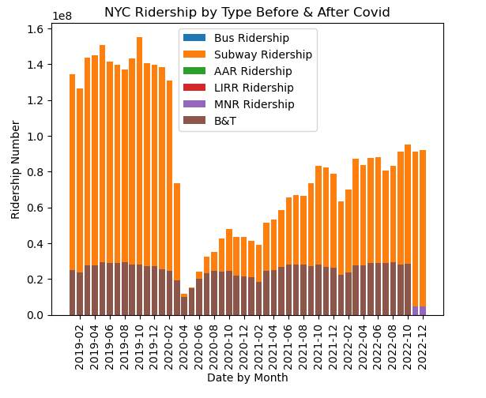
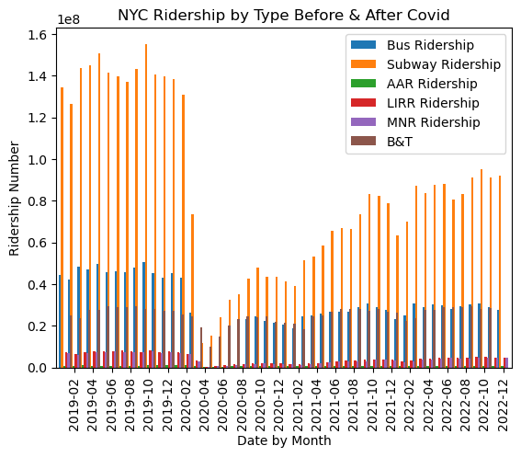
PANDEMIC & NYC ENERGY, GAS, & PUBLIC TRANSPORTATION TRENDS
3(B) Has public transportation usage as a whole returned to pre-pandemic levels?
This is a different representation of the information above.

Slide 9
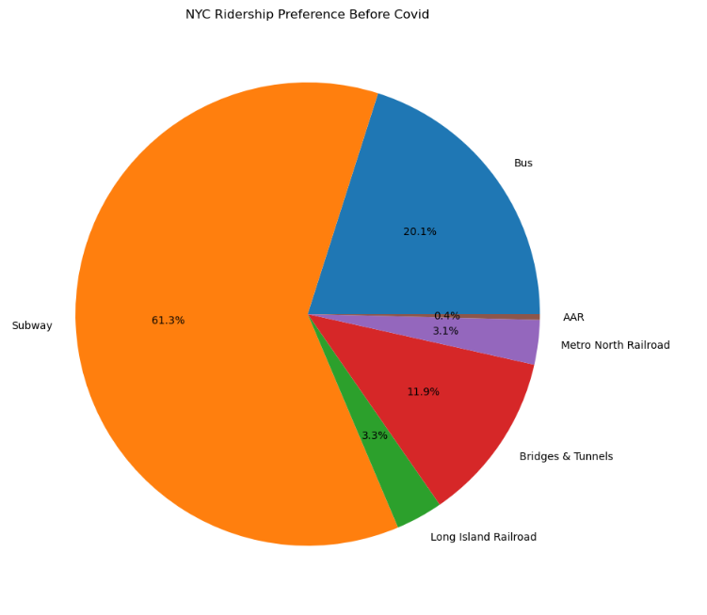
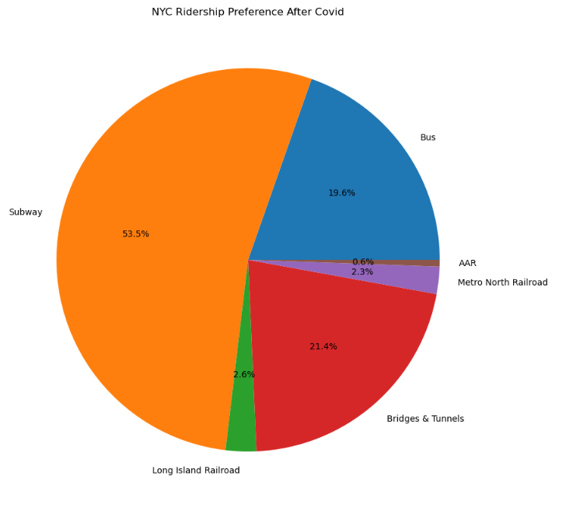
PANDEMIC & NYC ENERGY, GAS, & PUBLIC TRANSPORTATION TRENDS
4(A). Has preference for public transportation changed after 2020?
Findings: There appears to be a transition away from subway usage towards bridges and tunnels.

